Slide 1

Augmented Reality
Presented by
Prakash K
765074

Slide 2
AGENDA
What is AR?
HISTORY
How does it work?
Types of AR
Applications
Augmented Reality vs. Virtual Reality
SDKs and Frameworks
Conclusion
Demo
References

Slide 3

What is AR?
Augmented reality is the technology that expands our physical world, adding layers of digital information onto it. Unlike Virtual Reality (VR), AR does not create the whole artificial environments to replace real with a virtual one. AR appears in direct view of an existing environment and adds sounds, videos, graphics to it.
A view of the physical real-world environment with superimposed computer-generated images, thus changing the perception of reality, is the AR

Slide 4

HISTORY
In 1901 L. Frank Baum, an author, first mentions the idea of an electronic display/spectacles that overlays data onto real life. It is named a 'character marker'.
In 1962 Morton Heilig, a cinematographer, creates and patents a simulator called Sensorama with visuals, sound, vibration, and smell.
In 1990 The term 'Augmented Reality' is attributed to Thomas P. Caudell, a former Boeing researcher.
In 1992 Louis Rosenberg developed one of the first functioning AR systems, called Virtual Fixtures, at the United States Air Force Research Laboratory—Armstrong, that demonstrated benefit to human perception.
Since then, AR’s growth and progress have been remarkable.

Slide 5

How does it work?
For AR a certain range of data (images, animations, videos, 3D models) may be used and people will see the result in both natural and synthetic light. Also, users are aware of being in the real world which is advanced by computer vision, unlike in VR.
AR can be displayed on various devices: screens, glasses, handheld devices, mobile phones, head-mounted displays.

Slide 6
It involves technologies like S.L.A.M. (simultaneous localization and mapping), depth tracking (briefly, a sensor data calculating the distance to the objects), and the following components.
Cameras and sensors.
Processing.
Projection.
Reflection.

Slide 7
Augmented Reality vs. Virtual Reality
Augmented Reality
System augments the real world scene
User maintains a sense of presence in real world
Needs a mechanism to combine virtual and real worlds
Hard to register real and virtual
Virtual Reality
Totally immersive environment
Senses are under control of system
Need a mechanism to feed virtual world to user
Hard to make VR world interesting

Slide 8
Types of AR
There are 4 types of augmented reality :
marker-based AR
markerless AR
projection-based AR
superimposition-based AR

Slide 9
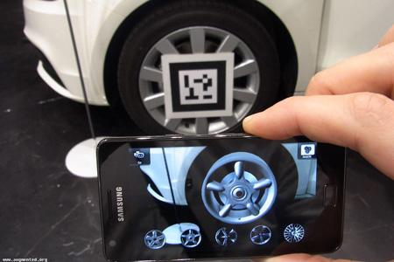
Marker Based Augmented Reality
Marker-based augmented reality (also called Image Recognition) uses a camera and some type of visual marker, such as a QR/2D code, to produce a result only when the marker is sensed by a reader. Distinct, but simple patterns (such as a QR Code) are used as the markers . The position and orientation is also calculated, in which some type of content and/or information is then over laied the marker.

Slide 10
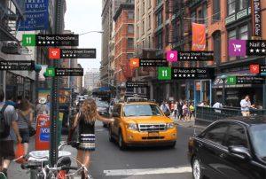
Markerless Augmented Reality
As one of the most widely implemented applications of augmented reality, markerless (also called location-based, position-based, or GPS) augmented reality, uses a GPS, digital compass, velocity meter, or accelerometer which is embedded in the device to provide data based on your location. A strong force behind markerless augmented reality technology is the wide availability of smartphones and location detection features they provide. It is most commonly used for mapping directions, finding nearby businesses, and other location-centric mobile applications.

Slide 11
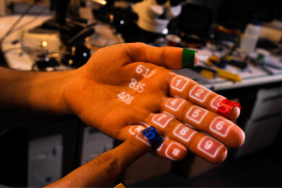
Projection Based AR
Projection based augmented reality works by projecting artificial light onto real world surfaces. applications allow for human interaction by sending light onto a real world surface and then sensing the human interaction (i.e. touch) of that projected light. Detecting the user’s interaction is done by differentiating between an expected (or known) projection and the altered projection (caused by the user’s interaction). Another interesting application of projection based augmented reality utilizes laser plasma technology to project a three-dimensional (3D) interactive hologram into mid-air.

Slide 12

Superimposition Based AR
Superimposition based augmented reality either partially or fully replaces the original view of an object with a newly augmented view of that same object. In superimposition based augmented reality, object recognition plays a vital role because the application cannot replace the original view with an augmented one if it cannot determine what the object is.

Slide 13
Applications
Medical
Manufacturing and repair
Gaming
Education
Military aircraft

Slide 14
SDKs and Frameworks
Kudan. AR SDK.
Simple CV.
Vuforia, Augmented Reality SDK.
Wikitude SDK.
ARToolKit.
ARKit

Slide 15
CONCLUSION
Augmented reality is another step further into the digital age as we will soon see our environments change dynamically either through a Smartphone, glasses, car windshields and even windows in the near future to display enhanced content and media right in front of us.
This has amazing applications that can very well allow us to live our lives more productively, more safely, and more informatively.

Slide 16

DEMO
Go to play store
Search for HP Reveal
https://www.youtube.com/watch?v=pEVKtPEcgQg
https://www.hpreveal/com

Slide 17
References
https://www.realitytechnologies.com/augmented-reality
https://thinkmobiles.com/blog/what-is-augmented-reality
https://en.wikipedia.org/wiki/Augmented_reality
https://themindstudios.com/blog/5-best-augmented-reality-sdks-and-frameworks

Slide 18
Any Queries?

Slide 19


